Slide 1

CS 334/534 Networking Midterm Exam Review

Slide 2
Physical Layer
Application
Service
Move information between two systems connected by a physical link
Interface
Specifies how to send one bit
Protocol
Encoding scheme for one bit
Voltage levels
Timing of signals
Examples: coaxial cable, fiber optics, radio frequency transmitters
Presentation
Session
Transport
Network
Data Link
Physical

Slide 3
Data Link Layer
Application
Service
Data framing: boundaries between packets
Media access control (MAC)
Per-hop reliability and flow control
Interface
Sends one packet between two hosts connected to the same media
Protocol
Physical addressing (e.g., MAC address)
Examples: Ethernet, WiFi, DOCSIS
Presentation
Session
Transport
Network
Data Link
Physical

Slide 4

Framing
Physical layer determines how bits are encoded
Next step, how to encode blocks of data?
Packet switched networks
Each packet includes routing information
Data boundaries must be known so headers can be read
Types of framing
Byte oriented protocols
Bit oriented protocols
Clock based protocols

Slide 5
Byte Oriented: Sentinel Approach
START
Data
DLE
DLE
DLE
END
END
Add START and END sentinels to the data
Problem: what if END appear in the data?
Add a special DLE (Data Link Escape) character before END
What if DLE appears in the data? Add DLE before it.
Similar to escape sequences in C
printf(“You must \”escape\” quotes in strings”);
printf(“You must \\escape\\ forward slashes as well”);
Used by Point-to-Point protocol, e.g. modem, DSL, cellular

Slide 6
Byte Oriented: Byte Counting
132
Data
Sender: insert length of the data in bytes at the beginning of each frame
Receiver: extract the length and read that many bytes

Slide 7
Bit Oriented: Bit Stuffing
01111110
Data
01111110
Add sentinels to the start and end of data
Both sentinels are the same
Example: 01111110 in High-level Data Link Protocol (HDLC)
Sender: insert a 0 after each 11111 in data
Known as “bit stuffing”
Receiver: after seeing 11111 in the data…
111110 → remove the 0 (it was stuffed)
111111 → look at one more bit
1111110 → end of frame
1111111 → error! Discard the frame
Disadvantage: 20% overhead at worst
Notes:
Sender adds a 0 after 5 1 bits. If the sender doesn’t do this, and 6 1s are in the payload followed by a 0, the receiver will read the data stream as an end flag. If there are 6 1s in the payload followed by a 1, the receiver will discard the frame. IT WILL ALWAYS STUFF. 20% at worst because after every 5th bit a 0 will be stuffed. 1/5 = 20%
Computer knows to throw away stuffed bit, it reads data like it wasn’t there, just knows not to terminate.

Slide 8
Clock-based Framing: SONET
Synchronous Optical Network
Transmission over very fast optical links
STS-n, e.g. STS-1: 51.84 Mbps, STS-768: 36.7 Gbps
STS-1 frames based on fixed sized frames
9*90 = 810 bytes
Physical layer details
Bits are encoded using NRZ
Payload is XORed with a special 127-bit pattern to avoid long sequences of 0 and 1
90 Columns
Special start pattern
Payload
9 Rows
Overhead
Notes:
STS – Synchronous Transport Signal.

Slide 9
Parity Bits
Idea: add extra bits to keep the number of 1s even
Example: 7-bit ASCII characters + 1 parity bit
0101001
1
1101001
0
1011110
1
0001110
1
0110100
1
Detects 1-bit errors
Not reliable against bursty errors
Notes:
Just makes the number of 1s even.
Failed Transmission Scenario – Alice sends 1001 parity bit 0 => 10010 … some transmission error … bob receives 11010 which is 1101 parity bit0 – Bob reports incorrect transmission
Burst Error – Multiple bits changed. The length of burst error is measured from first changed bit to last changed bit

Slide 10
Two Dimensional Parity
0101001
1101001
1011110
0001110
0110100
1011111
1
0
1
1
1
0
Parity bit for each row
Parity bit for each column
1111011
0
Parity bit for the parity byte
Can detect all 1-, 2-, and 3-bit errors, some 4-bit errors
14% overhead

Slide 11
Two Dimensional Parity Examples
0101001
1101001
1011110
0001110
0110100
1011111
1
0
1
1
1
0
1
0
Odd number of 1s
1
1
Odd number of 1s
1111011
0
Odd Number of 1s
Odd number of 1s

Slide 12
Checksums
Idea:
Add up the bytes in the data
Include the sum in the frame
Use ones-complement arithmetic
Lower overhead than parity: 16 bits per frame
But, not resilient to errors
Used in UDP, TCP, and IP
START
Data
Checksum
END
1
0
0101001
+
1101001= 10010010
Notes:
What is this called? Why is that important? Collisions. SHA 1 first collision took 2 years and 9 quintillion computations

Slide 13
Cyclic Redundancy Check (CRC)
Uses field theory to compute a semi-unique value for a given message
Much better performance than previous approaches
Fixed size overhead per frame (usually 32-bits)
Quick to implement in hardware
Only 1 in 2^32 chance of missing an error with 32-bit CRC
Details are going to be in the book/Wikipedia
Seriously, just google it and you should be fine ☺
Notes:
1 in a 4,294,967,296‬ -- 4.2 Trillion

Slide 14
Strategies for Media Access
Channel partitioning
Divide the resource into small pieces
Allocate each piece to one host
Example: Time Division Multi-Access (TDMA) cellular
Example: Frequency Division Multi-Access (FDMA) cellular
Taking turns
Tightly coordinate shared access to avoid collisions
Example: Token ring networks
Contention
Allow collisions, but use strategies to recover
Examples: Ethernet, WiFi

Slide 15
Contention Protocol Evolution
ALOHA
Developed in the 70s for packet radio networks
Slotted ALOHA
Start transmissions only at fixed time slots
Significantly fewer collisions than ALOHA
Carrier Sense Multiple Access (CSMA)
Start transmission only if the channel is idle
CSMA / Collision Detection (CSMA/CD)
Stop ongoing transmission if collision is detected

Slide 16
ALOHA
Topology: radio broadcast with multiple stations
Protocol:
Stations transmit data immediately
Receivers ACK all packets
No ACK = collision, wait a random time, then retransmit
Simple, but radical concept
Previous attempts all divided the channel
TDMA, FDMA, etc.
Optimized for the common case: few senders
A
B
C

Slide 17
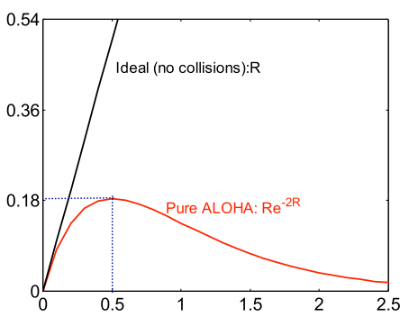
Tradeoffs vs. TDMA
In TDMA, each host must wait for its turn
Delay is proportional to number of hosts
In ALOHA, each host sends immediately
Much lower delay
But, much lower utilization
Throughput
2*Frame_Width
Sender A
ALOHA Frame
Sender B
ALOHA Frame
Time
Maximum throughput is ~18% of channel capacity
Load

Slide 18
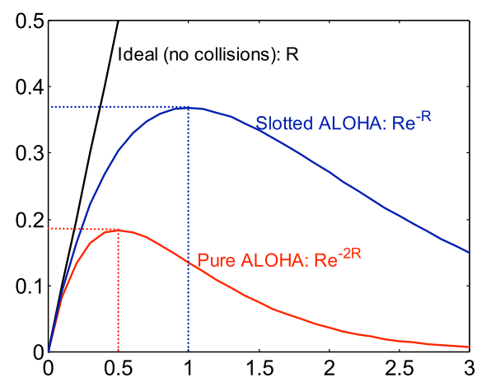
Slotted ALOHA
Protocol
Same as ALOHA, except time is divided into slots
Hosts may only transmit at beginning of a slot
Thus, frames either collide completely, or not at all
37% throughput vs. 18% for ALOHA
But, hosts must have synchronized clocks
Throughput
Load

Slide 19
802.3 Ethernet
Bytes
Preamble
SF
Source
Dest.
Length
Data
Pad
Checksum
Preamble is 7 bytes of 10101010. Why?
Start Frame (SF) is 10101011
Source and destination are MAC addresses
E.g. 00:45:A5:F3:25:0C
Broadcast: FF:FF:FF:FF:FF:FF
Minimum packet length of 64 bytes, hence the pad
Notes:
The preamble is to help synching clocks. It might take some time for the hardware to synchronize its clock with the other end of the connection, and there is a chance for some bits ot be lost too. The preamble is basically just a “ready, set…” and then the SF is the “GO”

Slide 20
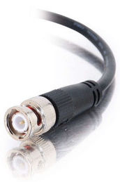

Broadcast Ethernet
Originally, Ethernet was a broadcast technology
Terminator
10Base2
Repeater
Tee Connector
Hubs and repeaters are layer-1 devices, i.e. physical only
10BaseT and 100BaseT
T stands for Twisted Pair
Hub

Slide 21
CSMA/CD
Carrier sense multiple access with collision detection
Key insight: wired protocol allows us to sense the medium
Algorithm
Sense for carrier
If carrier is present, wait for it to end
Sending would cause a collision and waste time
Send a frame and sense for collision
If no collision, then frame has been delivered
If collision, abort immediately
Why keep sending if the frame is already corrupted?
Perform exponential backoff then retransmit

Slide 22
CSMA/CD Collisions
Collisions can occur
Collisions are quickly detected and aborted
Note the role of distance, propagation delay, and frame length

Slide 23
Exponential Backoff
When a sender detects a collision, send “jam signal”
Make sure all hosts are aware of collision
Jam signal is 32 bits long (plus header overhead)
Exponential backoff operates in multiples of 512 bits
Select k ∈ [0, 2^{n} – 1], where n = number of collisions
Wait k * 51.2µs before retransmission
n is capped at 10, frame dropped after 16 collisions
Backoff time is divided into contention slots

Slide 24
Exponential Backoff
When a sender detects a collision, send “jam signal”
Make sure all hosts are aware of collision
Jam signal is 32 bits long (plus header overhead)
Exponential backoff operates in multiples of 512 bits
Select k ∈ [0, 2^{n} – 1], where n = number of collisions
Wait k * 51.2µs before retransmission
n is capped at 10, frame dropped after 16 collisions
Backoff time is divided into contention slots
Remember this number ☺

Slide 25
802.3 vs. Wireless
Ethernet has one shared collision domain
All hosts on a LAN can observe all transmissions
Wireless radios have small range compared to overall system
Collisions are local
Collision are at the receiver, not the sender
Carrier sense (CS in CSMA) plays a different role
802.11 uses CSMA/CA not CSMA/CD
Collision avoidance, rather than collision detection

Slide 26
Hidden Terminal Problem
Radios on the same network cannot always hear each other
Collision!
A
B
C
A cannot hear C
C cannot hear A
Hidden terminals mean that sender-side collision detection is useless
Notes:
A is too far from C and visa versa. B can hear both.

Slide 27
Exposed Terminal Problem
Carrier sense detects a busy channel
Carrier sensing is problematic in wireless
No collision
No collision
A
B
C
D
Carrier sense can erroneously reduce utilization

Slide 28
Reachability in Wireless
High level problem:
Reachability in wireless is not transitive
Just because A can reach B, and B can reach C, doesn’t mean A can reach C…
A
B
C
D

Slide 29
MACA
Multiple Access with Collision Avoidance
Developed in 1990
Sense the channel
The receiver is busy
Channel is idle
Host in
Sender’s
Range
Host in
Receiver’s
Range
Sender
Receiver
Soft-reserve the channel
RTS
RTS
CTS
CTS
RTS but no CTS = clear to send
Data
Data
Successful transmission
ACK
ACK
Notes:
Ready to Send
Clear to Send

Slide 30
Collisions in MACA
What if sender does not receive CTS or ACK?
Assume collision
Enter exponential backoff mode

Slide 31

The Case for Bridging
Need a device that can bridge different LANs
Only forward packets to intended recipients
No broadcast!
Send Packet
B → C
A
Send Packet
B → C
A
Bridge
B
Hub
B
C
C

Slide 32
Bridging the LANs
Hub
Hub
Bridging limits the size of collision domains
Vastly improves scalability
Question: could the whole Internet be one bridging domain?
Tradeoff: bridges are more complex than hubs
Physical layer device vs. data link layer device
Need memory buffers, packet processing hardware, routing tables

Slide 33
Bridges
Original form of Ethernet switch
Connect multiple IEEE 802 LANs at layer 2 (Data Link)
Goals
Reduce the collision domain
Complete transparency
Plug-and-play, self configuring
No hardware or software changes on hosts/hubs
Should not impact existing LAN operations
Hub

Slide 34
Bridges
Forwarding of frames
Learning of (MAC) addresses
Spanning Tree Algorithm (to handle loops)
Original form of Ethernet switch
Connect multiple IEEE 802 LANs at layer 2 (Data Link)
Goals
Reduce the collision domain
Complete transparency
Plug-and-play, self configuring
No hardware or software changes on hosts/hubs
Should not impact existing LAN operations
Hub

Slide 35
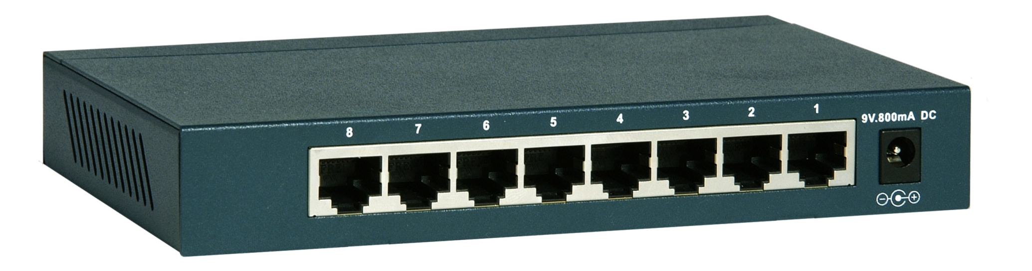
Frame Forwarding Tables
Each bridge maintains a forwarding table
MAC Address | Port | Age
00:00:00:00:00:AA | 1 | 1 minute
00:00:00:00:00:BB | 2 | 7 minutes
00:00:00:00:00:CC | 3 | 2 seconds
00:00:00:00:00:DD | 1 | 3 minutes

Slide 36
802.1 Spanning Tree Approach
Elect a bridge to be the root of the tree
Every bridge finds shortest path to the root
Union of these paths becomes the spanning tree
Bridges exchange Configuration Bridge Protocol Data Units (BPDUs) to build the tree
Used to elect the root bridge
Calculate shortest paths
Locate the next hop closest to the root, and its port
Select ports to be included in the spanning trees

Slide 37
Determining the Root
Initially, all hosts assume they are the root
Bridges broadcast BPDUs:
Based on received BPDUs, each switch chooses:
A new root (smallest known Root ID)
A new root port (what interface goes towards the root)
A new designated bridge (who is the next hop to the root)
Root ID
Path Cost to Root
Bridge ID

Slide 38
Comparing PBDUs
BPDU1
BPDU2
R1
Cost1
B1
R2
Cost2
B2
if R1 < R2: use BPDU1
else if R1 == R2 and Cost1 < Cost2: use BPDU1
else if R1 == R2 and Cost1 == Cost 2 and B1 < B2:
use BPDU1
else: use BPDU2

Slide 39
Bridges vs Switches
Bridges make it possible to increase LAN capacity
Reduces the amount of broadcast packets
No loops
Switch is a special case of a bridge
Each port is connected to a single host
Either a client machine
Or another switch
Links are full duplex
Simplified hardware: no need for CSMA/CD!
Can have different speeds on each port

Slide 40
Network Layer
Application
Service
Deliver packets across the network
Handle fragmentation/reassembly
Packet scheduling
Buffer management
Interface
Send one packet to a specific destination
Protocol
Define globally unique addresses
Maintain routing tables
Examples: Internet Protocol (IP), IPv6
Presentation
Session
Transport
Network
Data Link
Physical

Slide 41

IP Addressing
IPv4: 32-bit addresses
Usually written in dotted notation, e.g. 192.168.21.76
Each number is a byte
Stored in Big Endian order
0
8
16
24
31
Decimal
192
168
21
76
Hex
C0
A8
15
4C
Binary
11000000
10101000
00010101
01001100

Slide 42
IP Addressing and Forwarding
Routing Table Requirements
For every possible IP, give the next hop
But for 32-bit addresses, 2³² possibilities!
Hierarchical address scheme
Separate the address into a network and a host
0
31
Pfx
Network
Host
Known by all routers
Known by edge (LAN) routers
Notes:
Prefix – Essentially what you are assignened

Slide 43
Classes of IP Addresses
0
1
8
16
24
31
Class A
0
Ntwk
Host
Example: MIT
18.*.*.*
1-126
0
2
8
16
24
31
Class B
10
Network
Host
Example: UAB
138.26.*.*
128-191
0
3
8
16
24
31
Class C
110
Network
Host
Example:
216.63.78.*
192-223

Slide 44
IP Header Fields: Word 3
Time to Live: decremented by each router
Used to kill looping packets
Protocol: ID of encapsulated protocol
6 = TCP, 17 = UDP
Checksum
0
4
8
12
16
19
24
31
Version
HLen
DSCP/ECN
Datagram Length
Identifier
Flags
Offset
TTL
Protocol
Checksum
Source IP Address
Used to implement trace route
Destination IP Address
Options (if any, usually not)
Data

Slide 45

Problem: Fragmentation
MTU = 4000
MTU = 2000
MTU = 1500
Datagram
Dgram1
Dgram2
1
2
3
4
Problem: each network has its own MTU
DARPA principles: networks allowed to be heterogeneous
Minimum MTU may not be known for a given path
IP Solution: fragmentation
Split datagrams into pieces when MTU is reduced
Reassemble original datagram at the receiver
Notes:
A maximum transmission unit (MTU) is the largest size packet or frame, specified in octets (eight-bit bytes)

Slide 46
IP Header Fields: Word 2
Identifier: a unique number for the original datagram
Flags: M flag, i.e., this is the last fragment
Offset: byte position of the first byte in the fragment
Divided by 8
0
4
8
12
16
19
24
31
Version
HLen
TOS
Datagram Length
Identifier
Flags
Offset
TTL
Protocol
Checksum
Source IP Address
Destination IP Address
Options (if any, usually not)
Data
Notes:
Divide by 8 because you need 16 bits (2^16) - 1 = 65,535 to inform how many bytes you are sending, however, you only have 13 bits to do this. So to represent efficiently we need to scale down fragment offset field by (2^16)/(2^13) = 8

Slide 47
Fragmentation Example
MTU = 4000
MTU = 2000
MTU = 1500
Length = 2000, M = 1
Offset = 0
IP
Data
Length = 3820, M = 0
20
1980
IP Hdr
Data
3800
1980
+ 1820
= 3800
20
Length = 1840, M = 0
Offset = 1980
IP
Data
20
1820
Notes:
Length of Datagram - 3820
MTU is 2000
Datagram split into 2
1. Length 2000 as it is the max
Headers 20, Data 1980
2. Length 1840 as it is whats left
Headers 20, Data 1820

Slide 48
Fragmentation Example
MTU = 4000
MTU = 2000
MTU = 1500
Length = 2000, M = 1
Offset = 0
IP
Data
Length = 3820, M = 0
20
1980
IP Hdr
Data
3800
1980
+ 1820
= 3800
20
Length = 1840, M = 0
Offset = 1980
IP
Data
20
1820

Slide 49
IP Fragment Reassembly
Length = 1500, M = 1, Offset = 0
Performed at destination
M = 0 fragment gives us total data size
360 – 20 + 3460 = 3800
Challenges:
Out-of-order fragments
Duplicate fragments
Missing fragments
Basically, memory management nightmare
IP
Data
20
1480
Length = 520, M = 1, Offset = 1480
IP
Data
20
500
Length = 1500, M = 1, Offset = 1980
IP
Data
20
1480
Length = 360, M = 0, Offset = 3460
IP
Data
20
340
Notes:
Fragments need fragments because Datagram already fragmented when MTU went from 4000 to 2000. Then it dropped to 1500, thus needing the fragments to break into more fragments.

Slide 50

Host: sends packets of data
host sending function:
takes application message
breaks into smaller chunks, known as packets, of length L bits
transmits packet into access network at transmission rate R
link transmission rate, aka link capacity, aka link bandwidth
two packets,
L bits each
2
1
R: link transmission rate
host
packet
transmission
delay
time needed to
transmit L-bit
packet into link
L (bits)
R (bits/sec)
=
=

Slide 51

How do loss and delay occur?
packets queue in router buffers
packet arrival rate to link (temporarily) exceeds output link capacity
packets queue, wait for turn
packet being transmitted (delay)
A
B
packets queueing (delay)
free (available) buffers: arriving packets
dropped (loss) if no free buffers

Slide 52
Four sources of packet delay
transmission
A
propagation
B
nodal
processing
queueing
d_{nodal} = d_{proc} + d_{queue} + d_{trans} + d_{prop}
d_{proc}: nodal processing
check bit errors
determine output link
typically < msec
d_{queue}: queueing delay
time waiting at output link for transmission
depends on congestion level of router

Slide 53
Four sources of packet delay
transmission
A
propagation
B
nodal
processing
queueing
d_{nodal} = d_{proc} + d_{queue} + d_{trans} + d_{prop}
d_{trans}: transmission delay:
L: packet length (bits)
R: link bandwidth (bps)
d_{trans} = L/R
d_{prop}: propagation delay:
d: length of physical link
s: propagation speed in medium (~2x10⁸ m/sec)
d_{prop} = d/s
d_{trans} and d_{prop}
very different
* Check out the Java applet for an interactive animation on trans vs. prop delay
Notes:
53

Slide 54
Queueing delay example
Suppose 3 packets arrive simultaneously to a link at which no packets are currently being transmitted or queued. Each packet is of 8-bit length and the link has transmission rate 64 bits per sec (bps).
Packet 1 delay: 0 sec, because the queue is empty
Packet 2 delay: 8 / 64 sec
Packet 3 delay: 16/64 sec
Click here for a demo!
Notes:
54

Slide 55
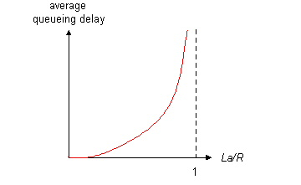

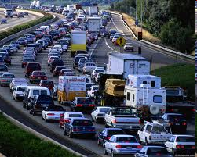
Queueing delay (revisited)
R: link bandwidth (bps)
L: packet length (bits)
a: average packet arrival rate
average queueing delay
traffic intensity
= La/R
La/R ~ 0: avg. queueing delay small
La/R -> 1: avg. queueing delay large
La/R > 1: more “work” arriving
than can be serviced, average delay infinite!
La/R ~ 0
* Check out the Java applet for an interactive animation on queuing and loss
La/R -> 1

Slide 56
“Real” Internet delays and routes
what do “real” Internet delay & loss look like?
traceroute program: provides delay measurement from source to router along end-end Internet path towards destination. For all i:
sends three packets that will reach router i on path towards destination
router i will return packets to sender
sender times interval between transmission and reply.
3 probes
3 probes
3 probes

Slide 57
“Real” Internet delays, routes
traceroute: gaia.cs.umass.edu to www.eurecom.fr
3 delay measurements from
gaia.cs.umass.edu to cs-gw.cs.umass.edu
1 cs-gw (128.119.240.254) 1 ms 1 ms 2 ms
2 border1-rt-fa5-1-0.gw.umass.edu (128.119.3.145) 1 ms 1 ms 2 ms
3 cht-vbns.gw.umass.edu (128.119.3.130) 6 ms 5 ms 5 ms
4 jn1-at1-0-0-19.wor.vbns.net (204.147.132.129) 16 ms 11 ms 13 ms
5 jn1-so7-0-0-0.wae.vbns.net (204.147.136.136) 21 ms 18 ms 18 ms
6 abilene-vbns.abilene.ucaid.edu (198.32.11.9) 22 ms 18 ms 22 ms
7 nycm-wash.abilene.ucaid.edu (198.32.8.46) 22 ms 22 ms 22 ms
8 62.40.103.253 (62.40.103.253) 104 ms 109 ms 106 ms
9 de2-1.de1.de.geant.net (62.40.96.129) 109 ms 102 ms 104 ms
10 de.fr1.fr.geant.net (62.40.96.50) 113 ms 121 ms 114 ms
11 renater-gw.fr1.fr.geant.net (62.40.103.54) 112 ms 114 ms 112 ms
12 nio-n2.cssi.renater.fr (193.51.206.13) 111 ms 114 ms 116 ms
13 nice.cssi.renater.fr (195.220.98.102) 123 ms 125 ms 124 ms
14 r3t2-nice.cssi.renater.fr (195.220.98.110) 126 ms 126 ms 124 ms
15 eurecom-valbonne.r3t2.ft.net (193.48.50.54) 135 ms 128 ms 133 ms
16 194.214.211.25 (194.214.211.25) 126 ms 128 ms 126 ms
17 * * *
18 * * *
19 fantasia.eurecom.fr (193.55.113.142) 132 ms 128 ms 136 ms
trans-oceanic
link
* means no response (probe lost, router not replying)
* Do some traceroutes from exotic countries at www.traceroute.org

Slide 58
Transport Layer
Application
Service
Multiplexing/demultiplexing
Congestion control
Reliable, in-order delivery
Interface
Send a message to a destination
Protocol
Port numbers
Reliability/error correction
Flow control information
Examples: UDP, TCP
Presentation
Session
Transport
Network
Data Link
Physical

Slide 59
Session Layer
Application
Service
Access management
Synchronization
Interface
It depends……………. ☺
Protocol
Token management
Insert checkpoints
Examples: none!
Presentation
Session
Transport
Network
Data Link
Physical
Notes:
Checkpointing – Fault Tolerance (Snapshots of connection state)

Slide 60
Presentation Layer
Application
Service
Convert data between different representations
E.g., big endian to little endian
E.g., ASCII to Unicode
Interface
It depends……………. ☺
Protocol
Define data formats
Apply transformation rules
Examples: Lets think about that
Presentation
Session
Transport
Network
Data Link
Physical
Notes:
What happens if your application assumes the payload is in ASCII but it’s really in some other character set like (Extended Binary) EBCDIC (Extended Binary Coded Decimal Interchange Code)
Big endian assumption but coded in little endian?

Slide 61
Application Layer
Application
Service
Whatever you want :D
Interface
Whatever you want :D :D :D
Protocol
Whatever you want :D :D :D :D :D :D :D :D
Examples: Take out your phone. Look at the apps you have installed. Pick one.
Presentation
Session
Transport
Network
Data Link
Physical

Slide 62
